Slide 1
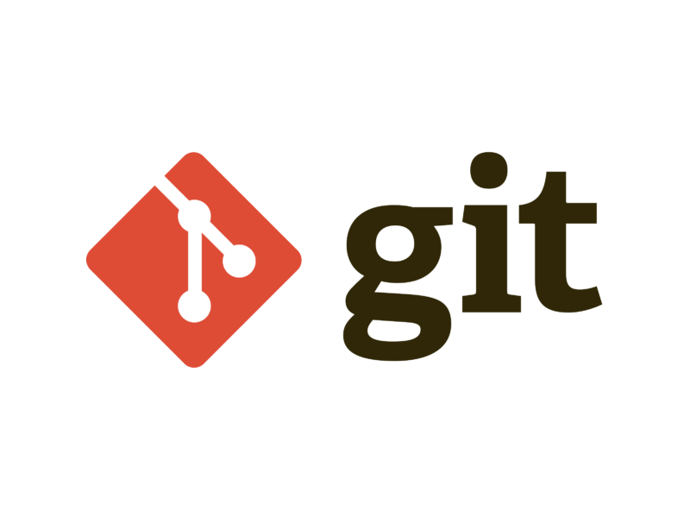
Mastering
Enter the Version Control Universe

Slide 2
Agenda
Introduction
What is Git
About Version Control System and Types
Difference between Centralized & Distributed version control system.
GIT Basics
GIT Command Line

Slide 3
Introduction
Git is a powerful and widely-used distributed version control system that enables developers to efficiently manage and track changes in their codebase.
Created by Linus Torvalds in 2005.
Git has become an essential tool for software development and collaboration.
Git is a distributed version control system (DVCS) that allows developers to track changes in their codebase, collaborate with others, and manage different versions of their projects efficiently

Slide 4
Key points
Version Control
Allows developers to keep track of changes made to their code over time, providing a history of modifications, who made them, and why.
Distributed System
Unlike centralized version control systems, Git is distributed, meaning every developer has a complete copy of the project's history on their local machine.
Branching
Git makes it easy to create branches, enabling developers to work on isolated features or bug fixes without affecting the main codebase.
This promotes parallel development and experimentation.
Collaboration
Git facilitates collaborative coding by providing tools for merging and resolving conflicts when multiple developers work on the same project simultaneously.

Slide 5
Key points
Snapshots
Git doesn't store just the changes between versions; it stores entire snapshots of the project at each commit. This ensures the integrity and reliability of your codebase.
Open Source
Git is open source, with a thriving community and a wealth of resources available for users. Platforms like GitHub, GitLab, and Bitbucket offer hosting services for Git repositories.
Version Control
Allows developers to keep track of changes made to their code over time, providing a history of modifications, who made them, and why.
Distributed System
Unlike centralized version control systems, Git is distributed, meaning every developer has a complete copy of the project's history on their local machine.

Slide 6
CVCS and DVCS
Centralized Version Control System (CVCS): | Distributed Version Control System (DVCS)
Central Repository | Local Repositories
Network Dependency | Decentralized Workflows
Concurrent Collaboration | Offline Work
Auditing and Compliance | Efficient Collaboration
Examples: | Examples:
SVN (Subversion) and CVS (Concurrent Versions System) | Git, Mercurial,

Slide 7
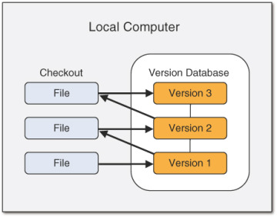
Local Version Control System

Slide 8
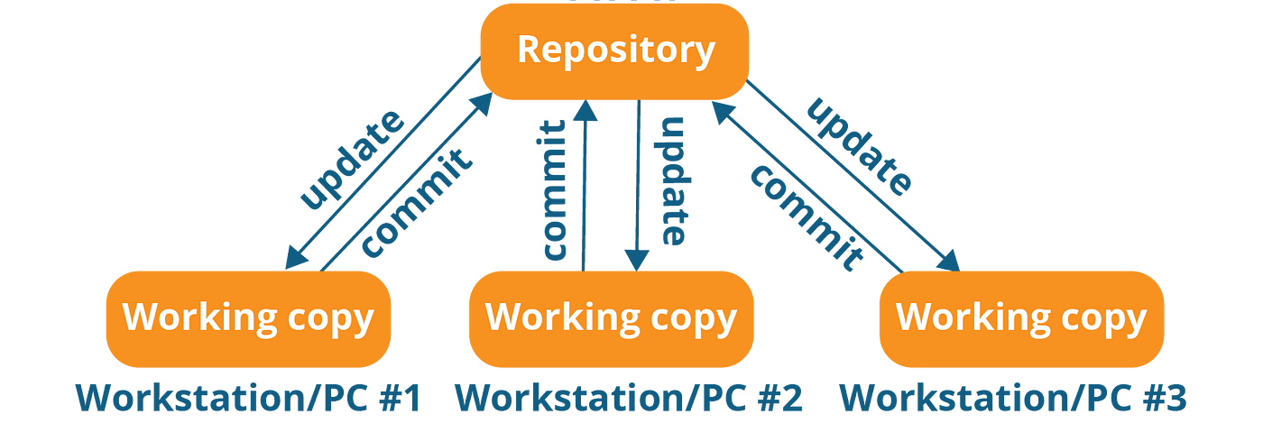
Centralized Version Control System

Slide 9
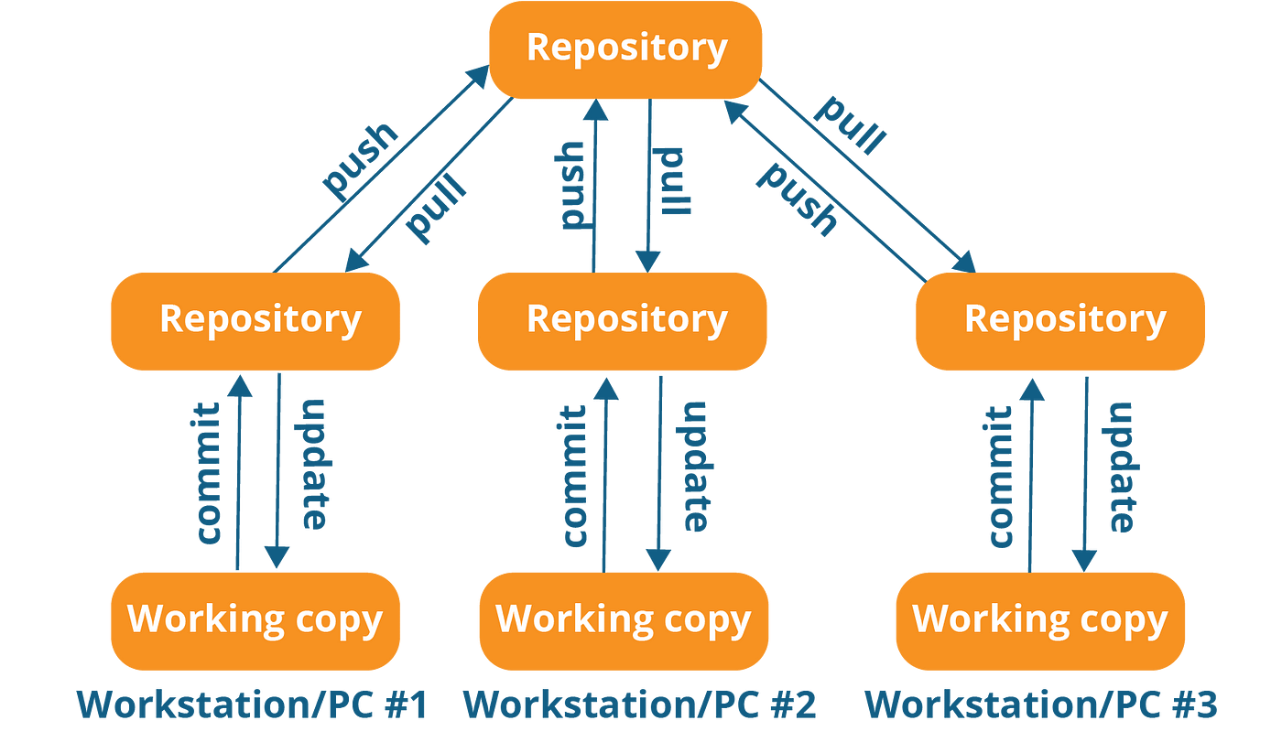
Distributed Version Control System

Slide 10
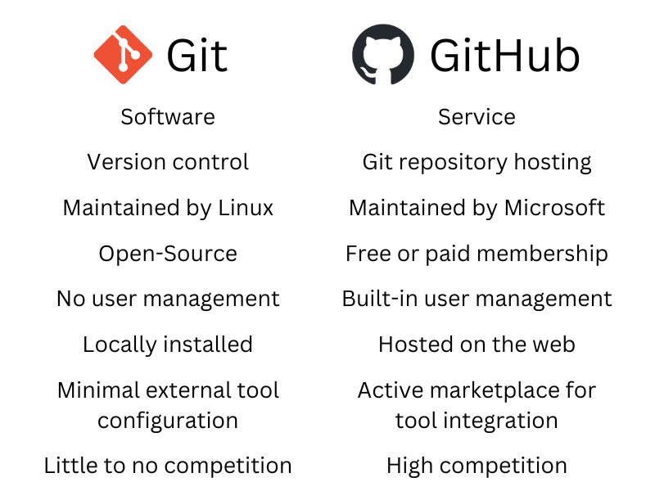
Git VS GitHub

Slide 11
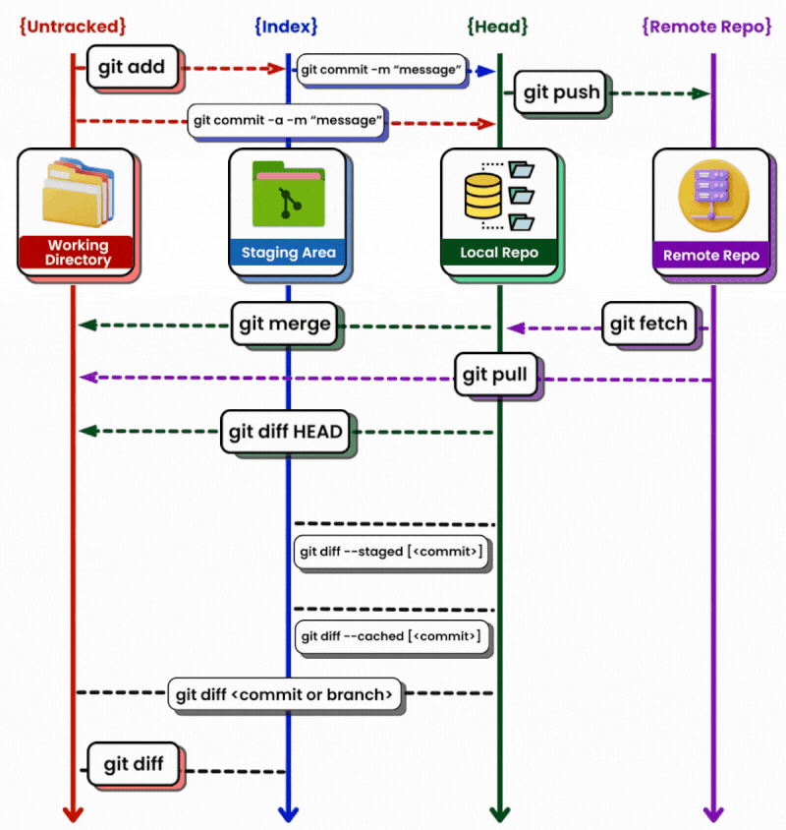
Working with Git Repositories

Slide 12
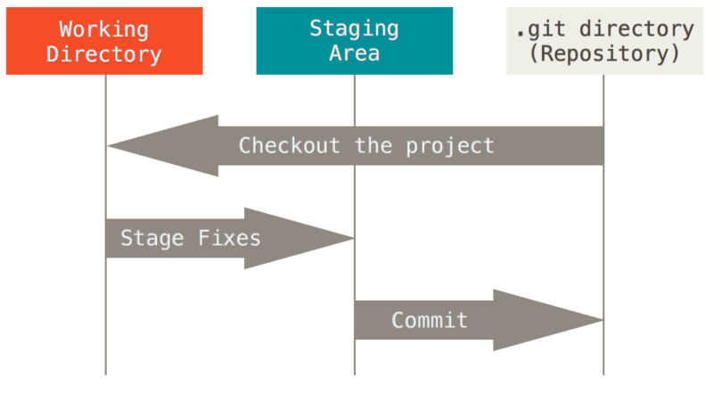
Three stage architecture of Git

Slide 13
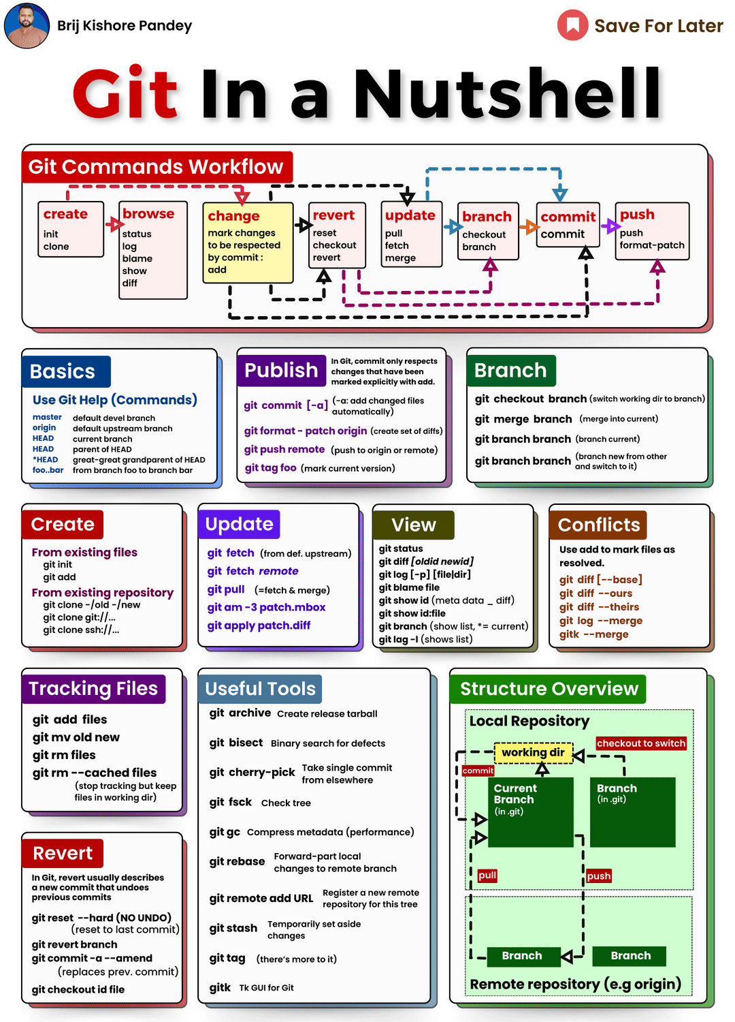
Git in a nutshell

Slide 14
Git in a nutshell

Slide 15
Git vs GitHub
Git | GitHub
Git is a software. | GitHub is a service.
Git is a command-line tool | GitHub is a graphical user interface
Git is installed locally on the system | GitHub is hosted on the web
Git is maintained by linux. | GitHub is maintained by Microsoft.
Git is focused on version control and code sharing. | GitHub is focused on centralized source code hosting.
Git is a version control system to manage source code history. | GitHub is a hosting service for Git repositories.
Git was first released in 2005. | GitHub was launched in 2008.
Git has no user management feature. | GitHub has a built-in user management feature.
Git is open-source licensed. | GitHub includes a free-tier and pay-for-use tier.
Git has minimal external tool configuration. | GitHub has an active marketplace for tool integration.
Git provides a Desktop interface named Git Gui. | GitHub provides a Desktop interface named GitHub Desktop.
Git competes with CVS, Azure DevOps Server, Subversion, Mercurial, etc. | GitHub competes with GitLab, Bit Bucket, AWS Code Commit, etc.

Slide 16
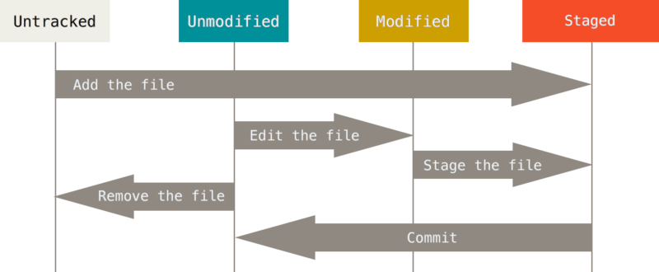
File Status lifecycle

Slide 17
Installation & Configuration
Websites:
# Go to https://git-scm.com/
Setting up the username:
# git config --global user.name "Jeetu"
Setting up the email ID:
# git config --global user.email "jitendrastomar5593@gmail.com"

Slide 18
Git Commands
Checking GIT version | git --version
Creating a directory | mkdir gitdemo2
Switching the dir | cd gitdemo2/
Listing the current data | ls
Creating a notepad file: | notepad demo.txt
Checking the current status: | git status
Initializing the GIT: | git init
Setting up the username: | git config --global user.name "Jeetu"
Setting up the email ID: | git config --global user.email "jitendrastomar5593@gmail.com"
Checking the default config: user. | git config --list
Initializing the GIT: | git init
Checking the status now: | git status
Adding the file(s) to the stagging | git add . //for multiple files
 | # git add <file1> <file2>...

Slide 19
Git Commands
Checking the status again: | git status
Adding the remote GIT repo: | git remote add origin https://github.com/jitendrastomar5593/gitdemo2.git
Setting up the main branch: | git branch -M main
Committing the code: | git commit -m "1st commit"
Pushing the data to git to main branch: | git push -u origin main // OR
 | git push origin main
Checking the log: | git log
Creating a new file: | notepad 2ndfile.txt
Adding this file to stagging: | git add 2ndfile.txt
Committing this code: | git commit -m "2nd commit"
Pushing the code GIT repo: | git push -u origin main
Checking the log again: | git log
Checking the remote: | git remote -v
Changing the remote URL: | git remote set-url origin https://github.com/jitendrastomar5593/gitdemo2.git
Checking the remote: | git remote -v

